Slide 1
Python/Raspberry PI 2
Dominion Over the Physical World
Todd Christell
todd@christell.com

Slide 2
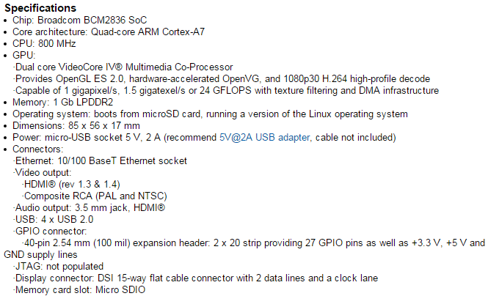
Raspberry PI 2 Specs

Slide 3
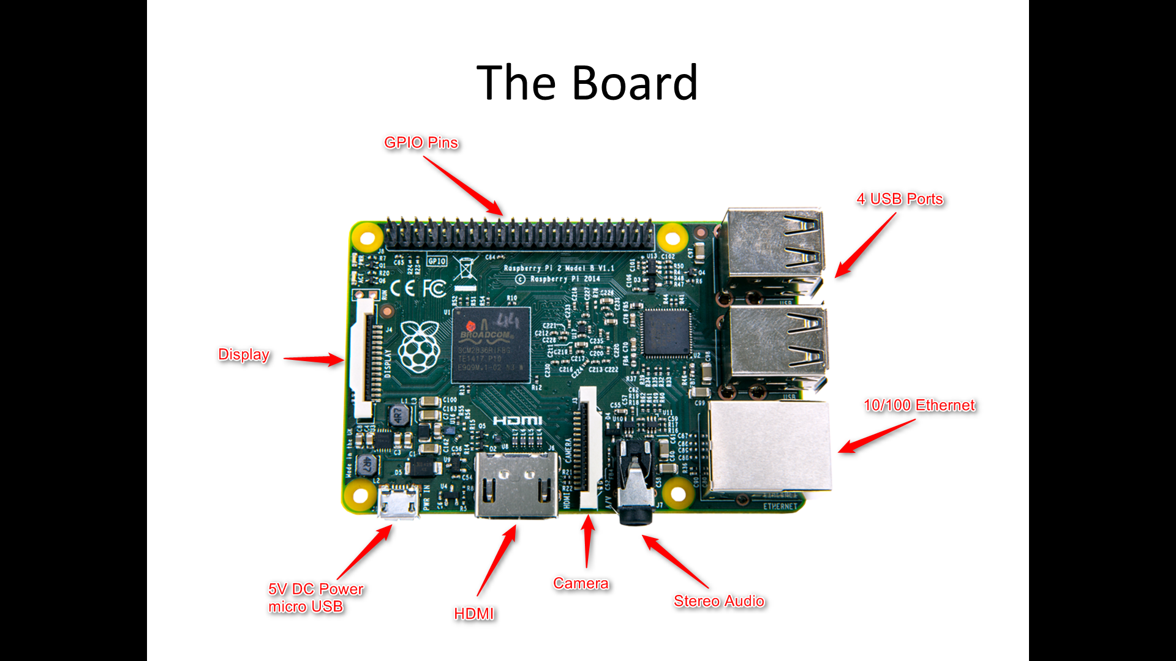

Slide 4
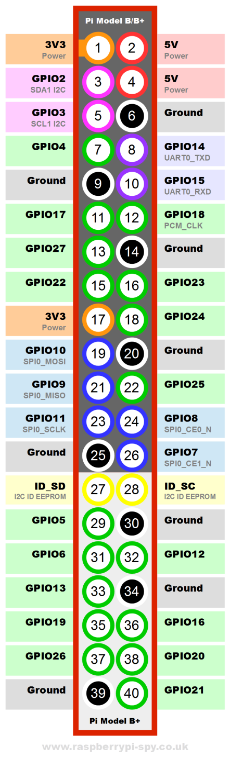
GPIO Pins

Slide 5
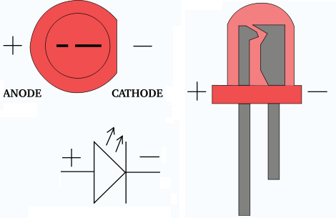
LED

Slide 6
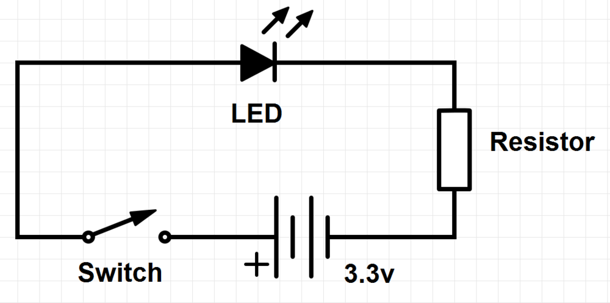
Basic LED Circuit (schematic)

Slide 7
Electric Current
Current is measured in milliamps (mA)
LED is a “constant current” device
It is NOT an incandescent lamp
Dependent on LED color; typically 20 mA
330Ω resistor will limit to ~10 mA
Dimmer but safer…

Slide 8
Resistors
Designated as R1, R2 etc. on diagrams
Measured in Ohms, K Ohms, M Ohms
Need only 220 Ω or 330Ω, 1KΩ and 10K Ω
Value is color coded
Chart or online calculator
An Amazon/eBay/China purchase

Slide 9
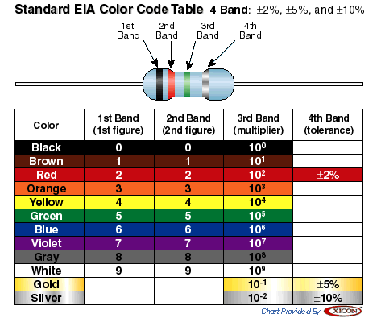
Resistor Color Code

Slide 10
Get the GPIO Library
sudo apt-get update
sudo apt-get upgrade
sudo apt-get install python-rpi.gpio

Slide 11
Basic LED Circuit

Slide 12
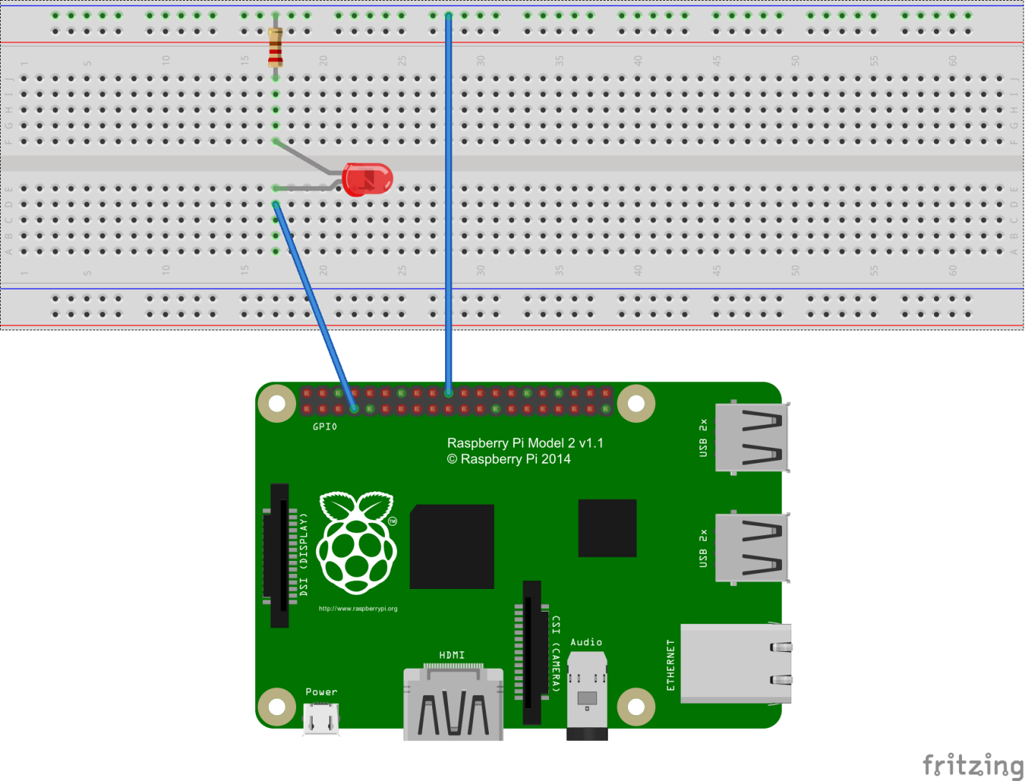
Raspberry PI Basic LED “Hello Physical World”
Power (+)
VCC/VDD
Ground (-)
VSS

Slide 13
GPIO CODE
import RPi.GPIO as GPIO
GPIO.setmode(GPIO.BCM)
GPIO.setwarnings(False)
GPIO.setup(pin, GPIO.OUT)
GPIO.output(pin, 1)

Slide 14
Limitations & Warnings
Each pin can supply 16 mA
Total board current draw of 50 mA
But pins will “try” to provide as much current as you request
Ultimately destroying the pin (at least…)

Slide 15
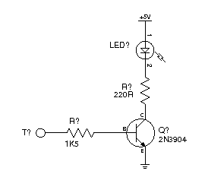
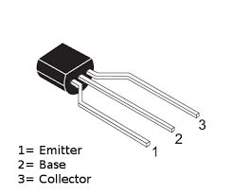
Transistor to Increase Current

Slide 16
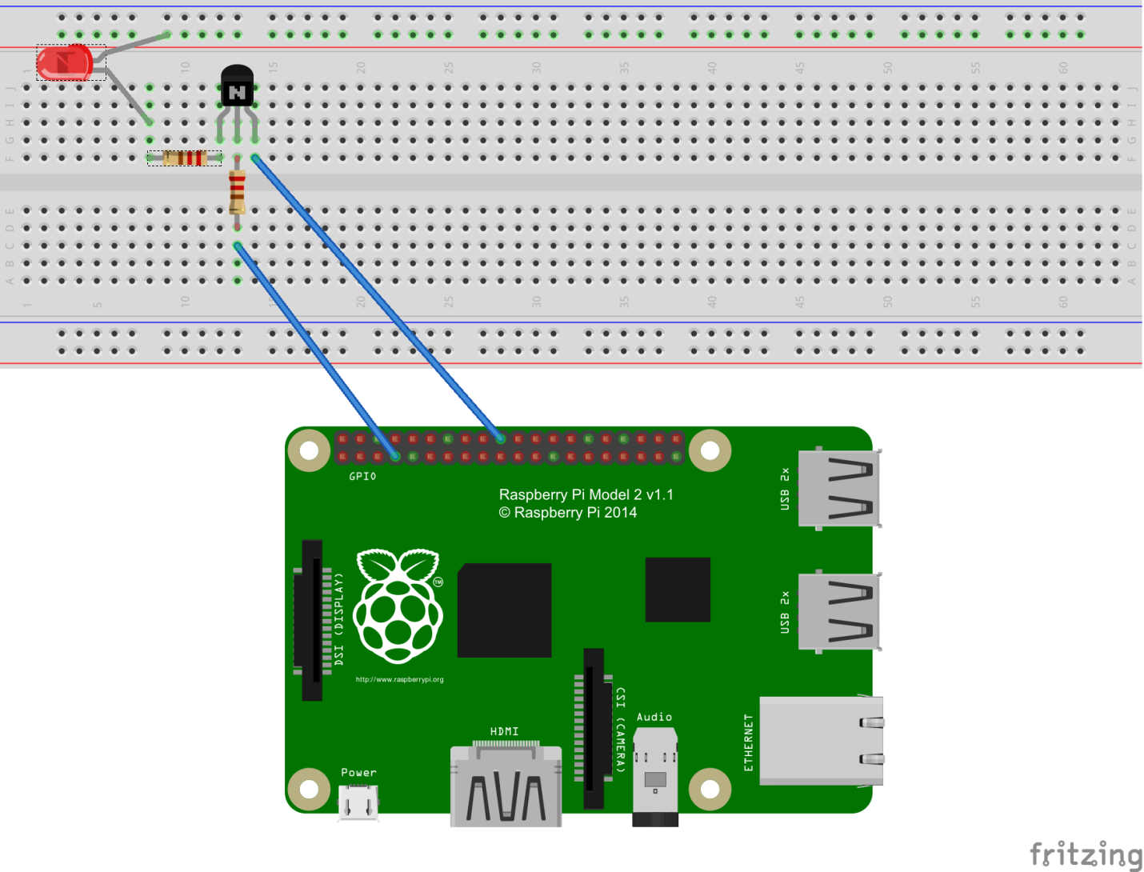
Transistor Switch

Slide 17

“You’re going to need a bigger boat”

Slide 18
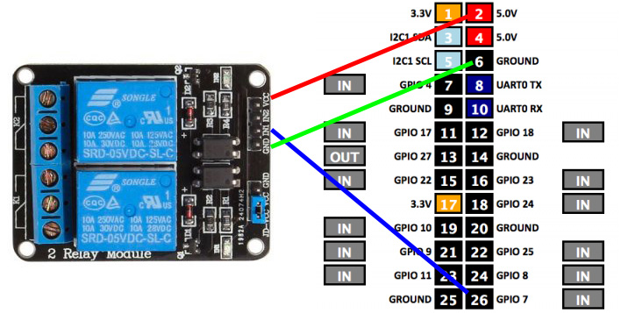
Relay for More Current

Slide 19
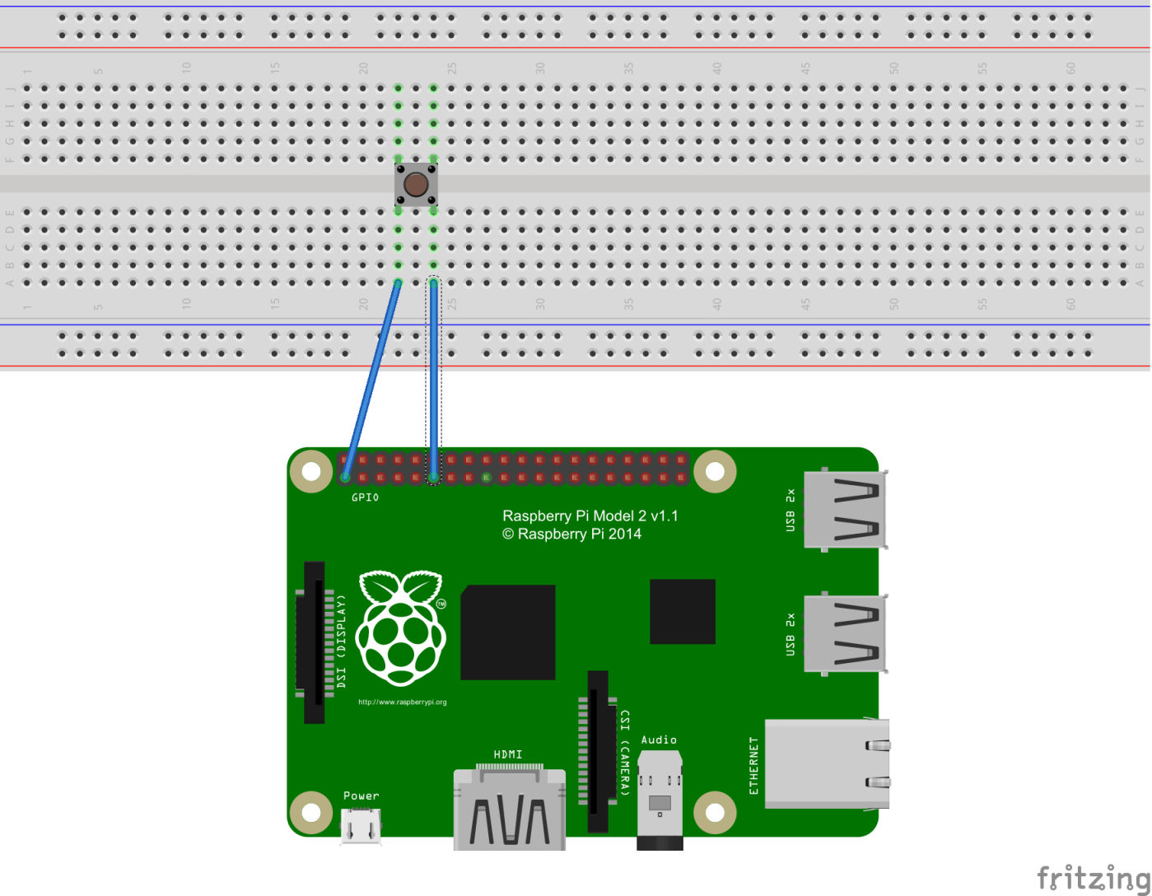
Basic Input

Slide 20
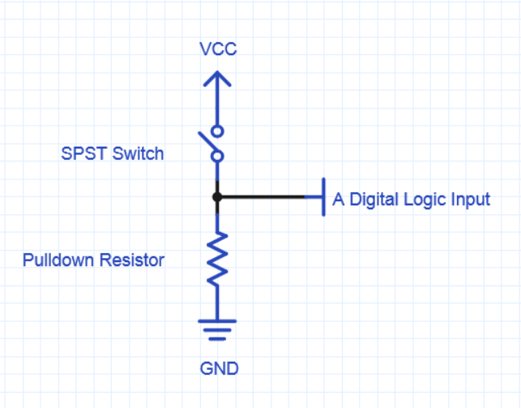
Pull Down Resistor

Slide 21
CODE
GPIO.setup(pin, GPIO.IN, GPIO.PUD_DOWN)
If GPIO.input(pin) == True

Slide 22
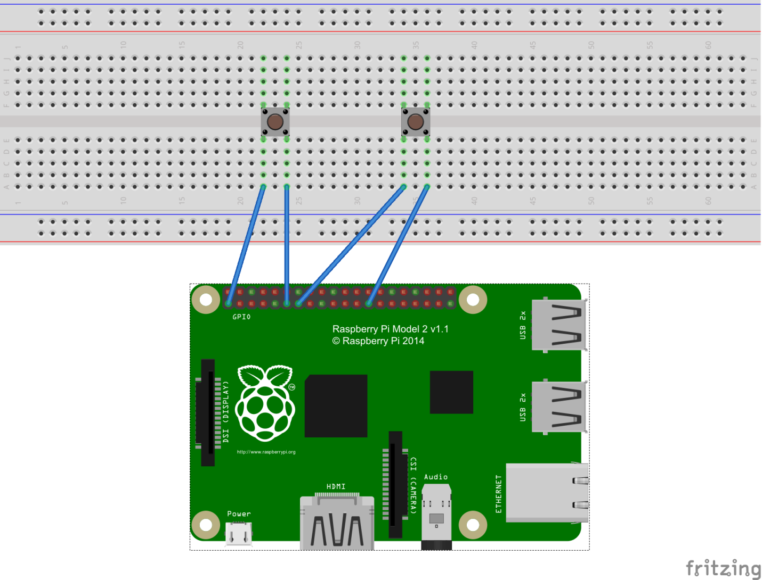
High vs. Low Inputs

Slide 23
CODE
GPIO.setup(15, GPIO.IN, GPIO.PUD_UP)
GPIO.setup(16, GPIO.IN, GPIO.PUD_DOWN)

Slide 24
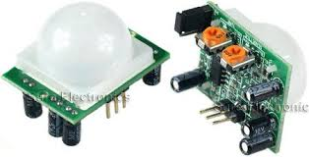
Many Sensors are Switches
Passive Infrared (PIR) Motion Sensor
Outputs +3.3 volts when motion sensed

Slide 25
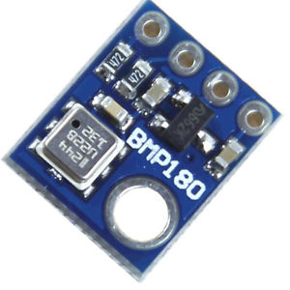
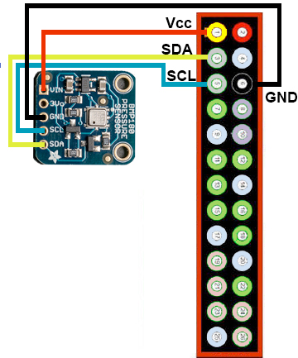
I2C Sensors
I2C is a universal communications protocol
Multiple sensors, 120 unique addresses
Simple use of Python libraries
BMP180 Temperature/Humidity/Altitude

Slide 26
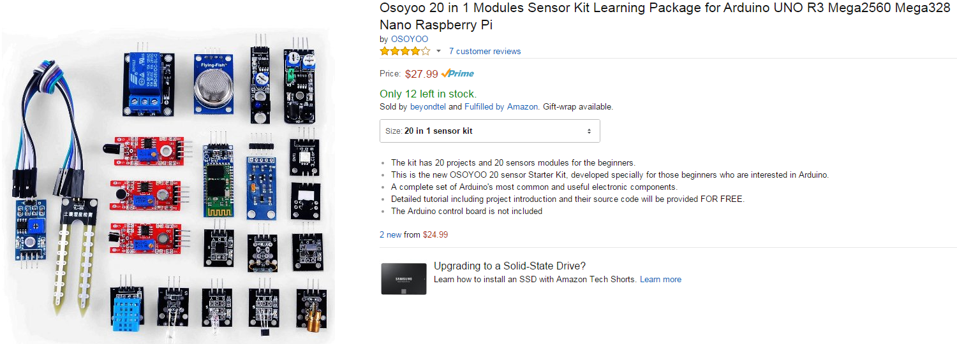
Sensor Pack

Slide 27
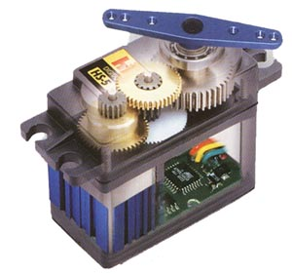
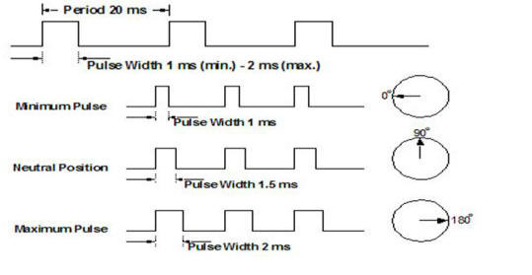
Servos

Slide 28
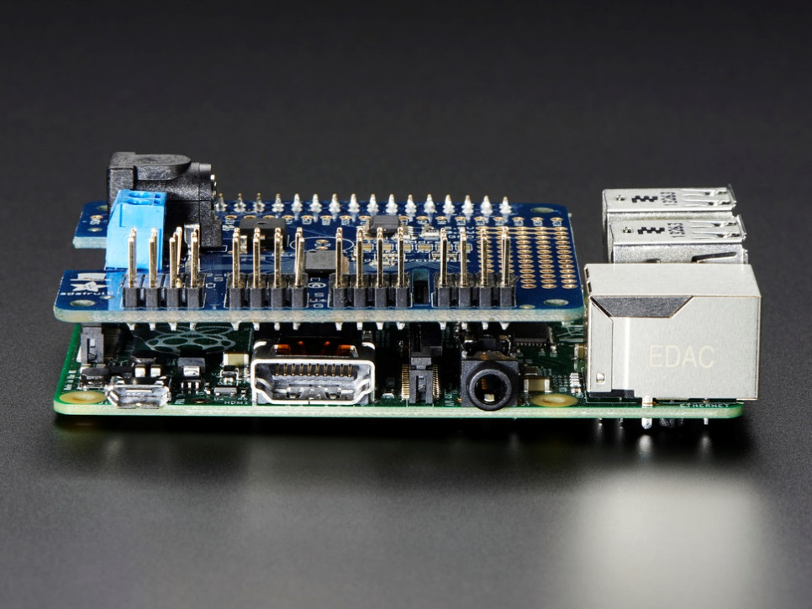
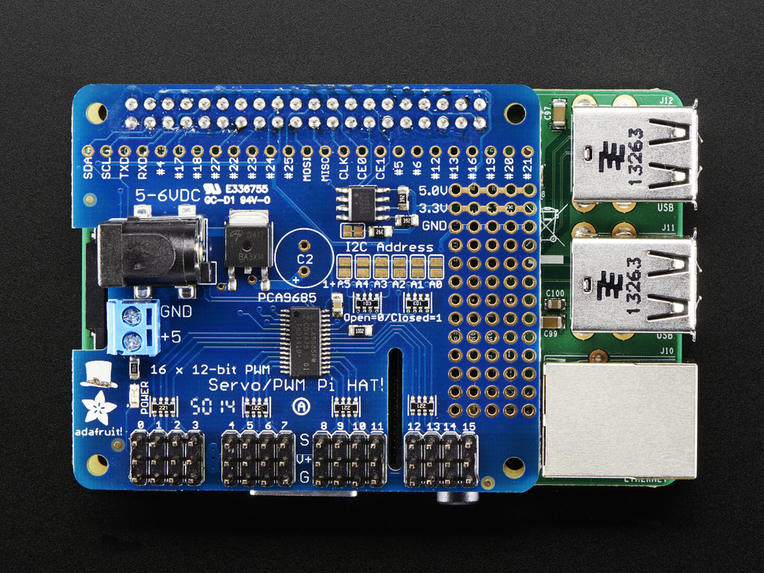
“Adafruit Servo HAT”

Slide 29
Gmail?
Monitor Gmail account
LED lights – “You have mail…”
Monitor push button (or sensor)
Detect and send email or text

Slide 30
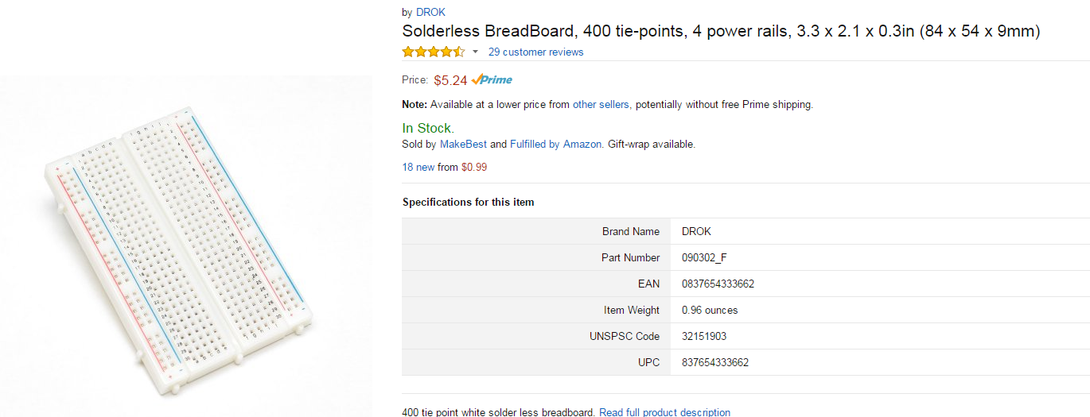
Solderless Breadboard

Slide 31
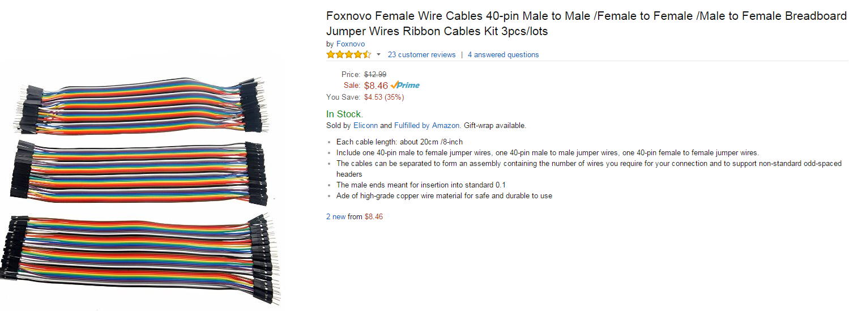
Breadboard Jumpers

Slide 32
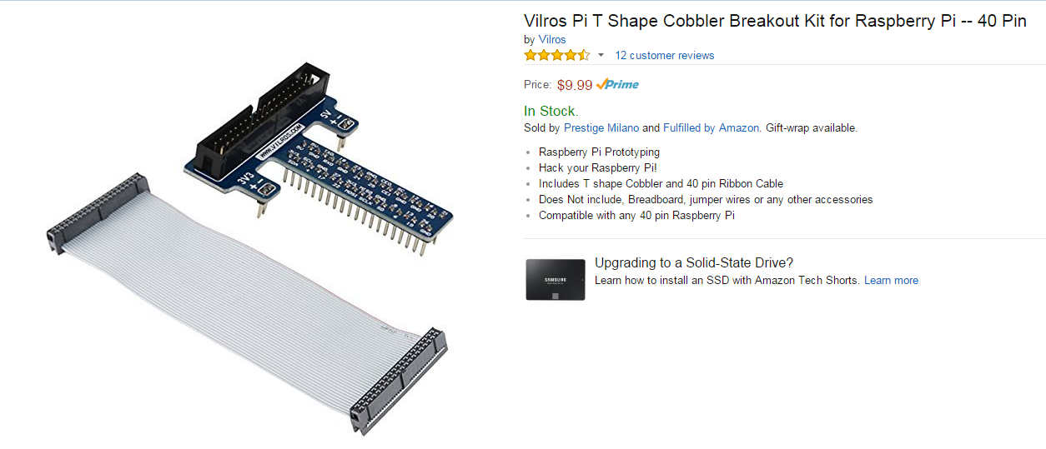
GPIO Extension

Slide 33
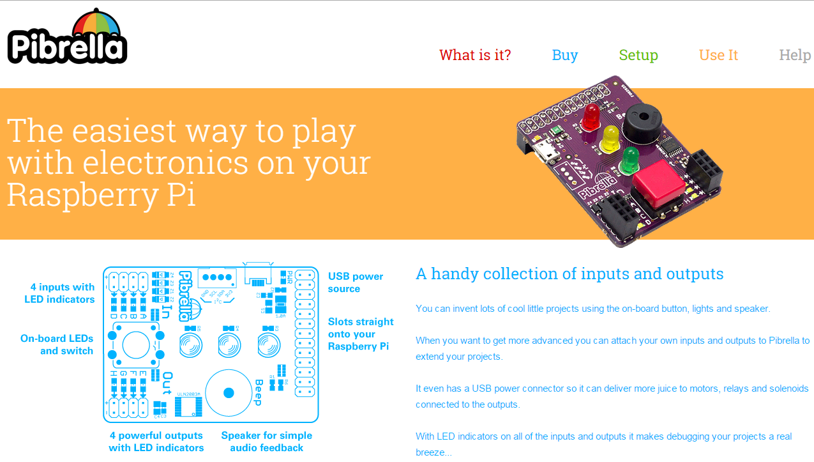
Hardware Demo Board

Slide 34
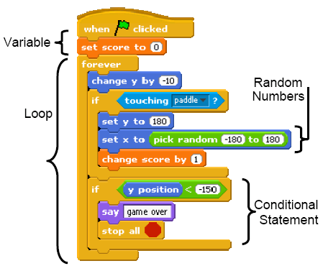
“Scratch” Programming Language

Slide 35
Links
Make Magazine GPIO Tutorial
http://makezine.com/projects/tutorial-raspberry-pi-gpio-pins-and-python/
Official GPIO Documentation
https://www.raspberrypi.org/documentation/usage/gpio/
How to choose resistors for LEDs
http://www.evilmadscientist.com/2012/resistors-for-leds/
http://led.linear1.org/led.wiz
Sparkfun tutorial on transistor switches
https://learn.sparkfun.com/tutorials/transistors/applications-i-switches
I2C
http://www.raspberrypi-spy.co.uk/2014/11/enabling-the-i2c-interface-on-the-raspberry-pi/
http://www.raspberry-projects.com/pi/programming-in-python/i2c-programming-in-python/using-the-i2c-interface-2
Adafruit Servo HAT
http://www.adafruit.com/products/2327
Scratch Programming Language
https://scratch.mit.edu/

